Slide 1
VHDL programming with ISE 14.4
Logic Design Lab.
Spring 2014
Prof. Naehyuck Chang
(naehyuck@snu.ac.kr)
TA. Taeyoung Kim
(tykim@iris.snu.ac.kr)
TA. Duseok Kang
(kangds0829@iris.snu.ac.kr)
RUBIS

Slide 2
Outline
VHDL introduction
  History
  Basics – library, entity, architecture
  Three different types of programming (description)
Practice
  Design edge triggered D flip-fop
  Write VHDL test bench and get the simulation result
  Design simple shift register using edge triggered D flip-flop
Requirement
  In lab
    Design universal shift register (Lecture note #6, 29 page) and show your simulation result
    Hint) Design edge triggered D flip-flop and multiplexer first (Lecture note #6, 30 page)
  On your result report
    VHDL basic
    Design any combinational logic and show your codes and simulation result
    Design any sequential logic and show your codes and simulation result
    Too simple logic won’t get high score (ex. 2-input and gate)
RUBIS

Slide 3
Why people use HDLs
Advantages of VHDL
  IEEE standard
  Common
  Flexible – Delay modeling, Matrices …
  Describe hardware at varying levels of abstraction
  ( = Describe hardware to other people briefly )
Define simulation semantics
RUBIS

Slide 4
VHDL history
VHDL (circa 1987)
  US DoD (Department of defense) sponsored standard
  similar to Ada (emphasis on re-use and maintainability)
  simulation semantics visible
  very general but verbose
  IEEE standard
Verilog and VHDL are the most popular HDLs
  Verilog is more popular in industry ☺
RUBIS

Slide 5
Simple VHDL example
library IEEE;
use IEEE.STD_LOGIC_1164.ALL;
entity basic_and is
Port ( a : in STD_LOGIC;
b : in STD_LOGIC;
output : out STD_LOGIC);
end basic_and;
architecture Behavioral of basic_and is
begin
output <= a and b;
end Behavioral;
#include <stddef>
bool and (bool a, bool b);
bool and (bool a, bool b) {
bool out;
out = a && b;
return out;
}
RUBIS

Slide 6
Library
library IEEE;
use IEEE.STD_LOGIC_1164.ALL;
Definition of required packages (libraries), e.g., std_logic_1164
Import std_logic from the
IEEE library
IEEE.STD_LOGIC_1164
Character | Value
'U' | uninitialized
'X' | strong drive, unknown logic value
'0' | strong drive, logic zero
'1' | strong drive, logic one
'Z' | high impedance
'W' | weak drive, unknown logic value
'L' | weak drive, logic zero
'H' | weak drive, logic one
'-' | don't care
RUBIS

Slide 7
Entity declaration
entity basic_and is
Port ( a : in STD_LOGIC;
b : in STD_LOGIC;
output : out STD_LOGIC);
end basic_and;
An Entity corresponds to the interface of a component.
Declare an entity
Define input / output port
You can use STD_LOGIC_VECTOR also
  Ex) a0_3 : in STD_LOGIC_VECTOR ( 3 downto 0);
RUBIS

Slide 8
Architecture description
architecture Behavioral of basic_and is
begin
output <= a and b;
end Behavioral;
An Architecture describes its behavior.
Define functionality of the entity
‘<=‘ means substitution (in C language, ‘=‘)
RUBIS

Slide 9
Three different types of description
Structural description contains
  signal declarations, for internal interconnections.
  component instances.
  Port maps in an component instances.
RUBIS

Slide 10
Three different types of description
Structural description
  Describes how gates are interconnected similar to schematic approach
  Hierarchical composition of modules from primitives
architecture Behavioral of nand_gate is
signal wire0 : STD_LOGIC;
component inv port ( o: out STD_LOGIC, i : in STD_LOGIC);
end component;
component and_gate port ( o: out STD_LOGIC, a, b : in STD_LOGIC);
end component;
begin
  U1 : and_gate port map (wire0, a, b);
  U2 : inv port map (output, wire0);
end Behavioral;
wire0
a
output
b
RUBIS

Slide 11
Three different types of description
Data-flow description
  Describes how the data flows from the inputs to the output most often using NOT, AND and OR operations
architecture Behavioral of nand_gate is
signal wire0 : std_logic;
begin
  wire0 <= A and B after 2 ns;
  Output <= not wire0 after 2 ns;
end Behavioral;
wire0
a
output
b
RUBIS

Slide 12
Three different types of description
Behavioral description may contain
  Process statements
  Sequential statements
  Signal assignment statements
  Wait statements (not synthesizable)
RUBIS

Slide 13
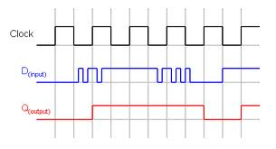
Three different types of description
Behavioral description
  Describes the algorithm performed by the module (= how the output is derived from the inputs using structured statements)
  process is executed whenever source is changed
entity edge_d is
Port ( d : in STD_LOGIC;
CLK : in STD_LOGIC;
q : out STD_LOGIC);
end edge_d ;
architecture Behavioral of edge_d is
begin
process(CLK)
begin
if (rising_edge(CLK)) then Q <= D;
end if;
end process;
end Behavioral;
Whenever CLK is changed
RUBIS

Slide 14
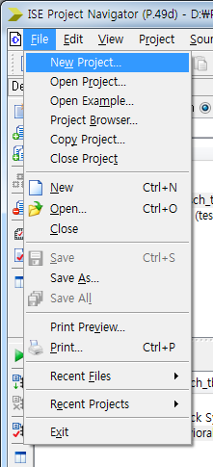
Create a new VHDL project
RUBIS

Slide 15
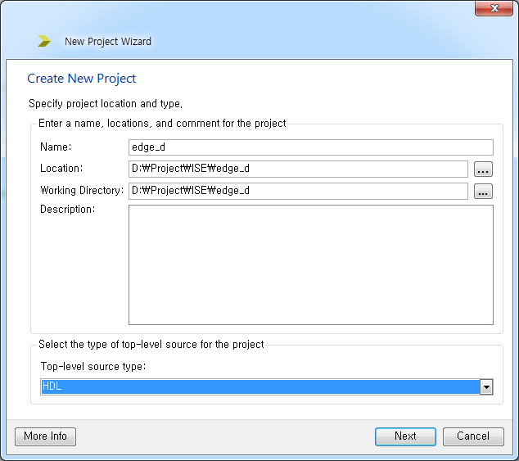
Set the project name, location, type
RUBIS

Slide 16
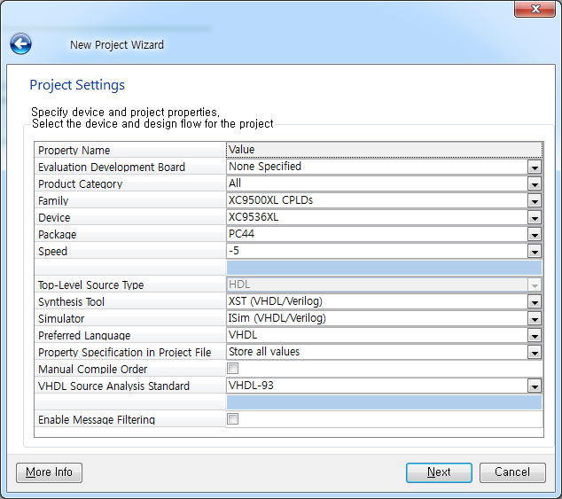
Set the project name, location, type
RUBIS

Slide 17
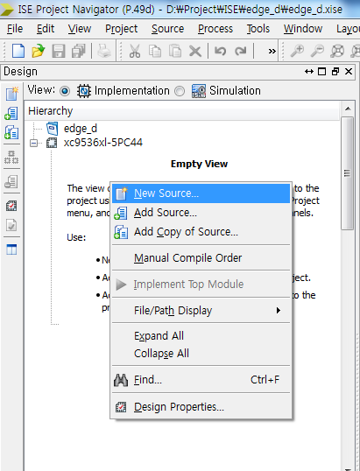
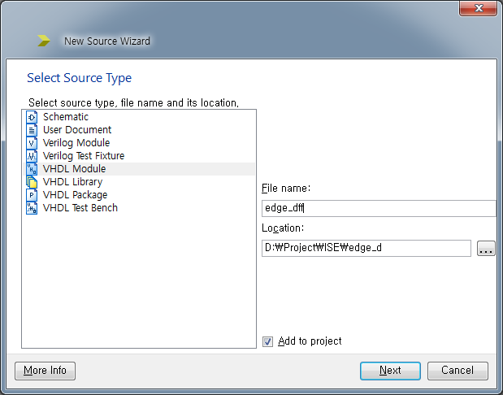
Create a new VHDL source
RUBIS

Slide 18
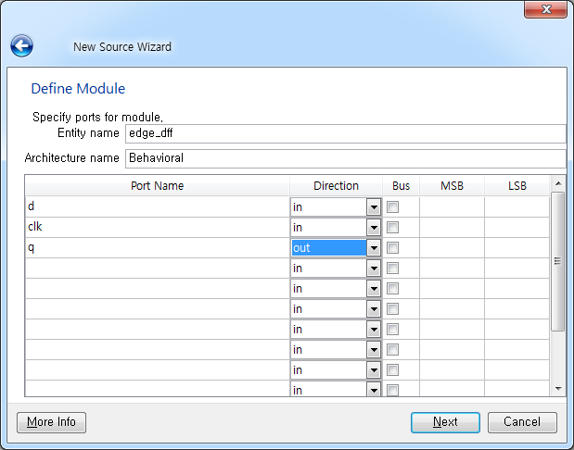
Create a new VHDL source
RUBIS

Slide 19
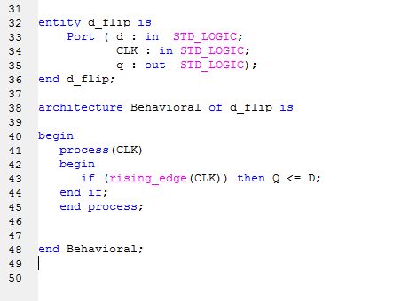
Write your own VHDL codes
edge_diff
edge_diff
edge_diff
RUBIS

Slide 20
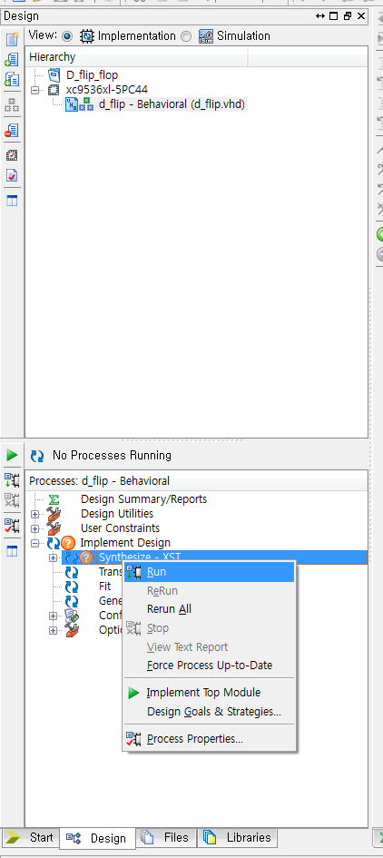
Compile and check errors
RUBIS

Slide 21
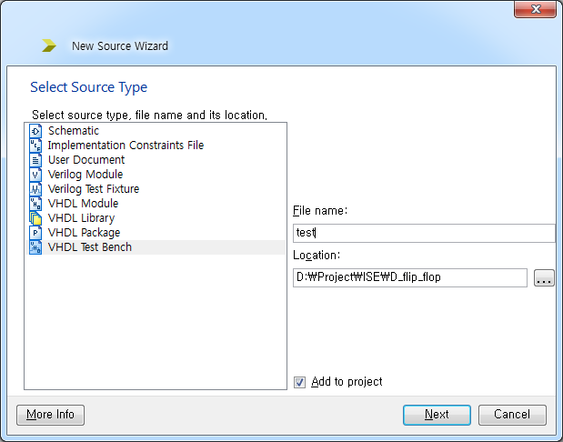
Create a VHDL test bench
RUBIS

Slide 22
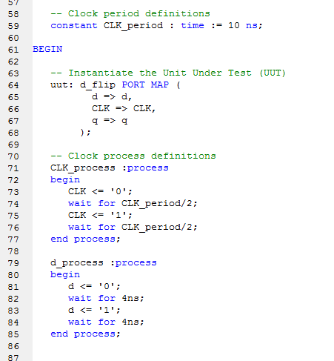
Write a VHDL test bench codes
RUBIS

Slide 23
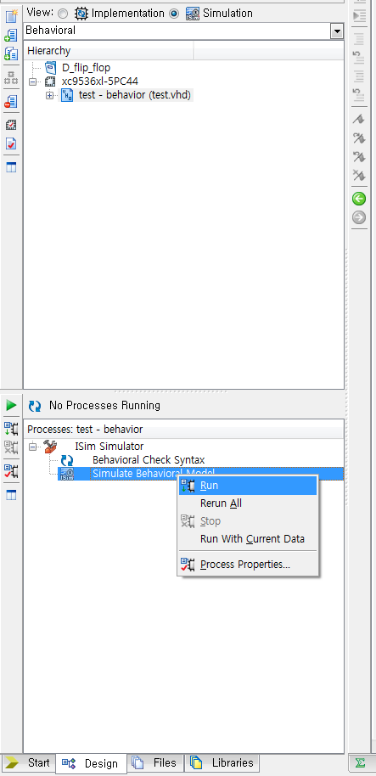
Simulate it
RUBIS

Slide 24
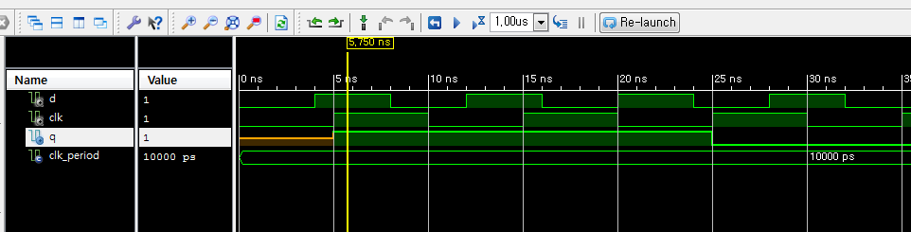
Simulation result
RUBIS

Slide 25
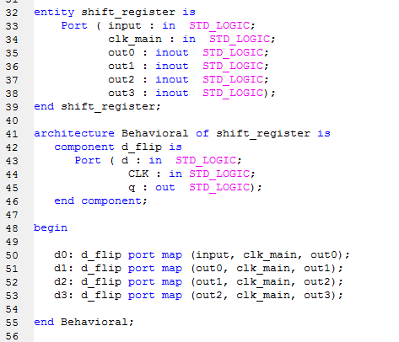
Design shift register using edge triggered D flip-flop
Create a new project
First, add new VHDL source (shift register)
Write shift register VHDL codes
Add existing D flip-flop component declaration
Use hierarchical composition technique
RUBIS

Slide 26
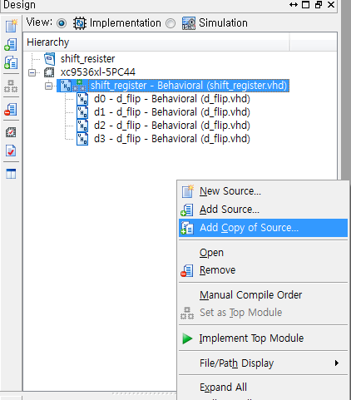
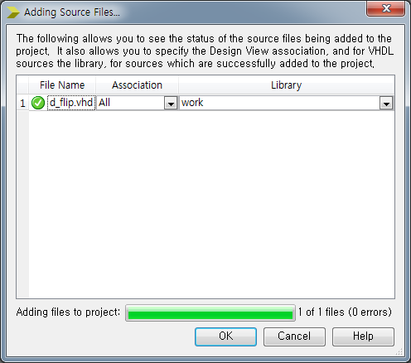
Design shift register using edge triggered D flip-flop
Add copy of existing D flip-flop source
RUBIS

Slide 27
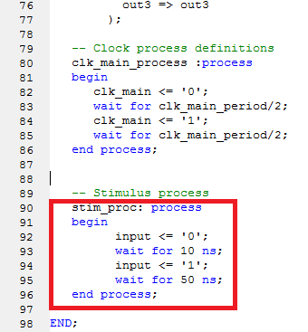
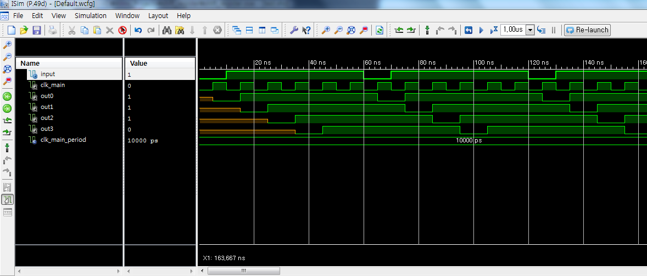
Shift register using edge triggered D flip-flop – Simulation result -
RUBIS

Slide 28
Requirement in lab
Design universal shift register (Lecture note #6, 29 page) and show your simulation result
  Hint
    Design edge triggered D flip-flop and multiplexer first
    You don’t have to implement and gate – Use boolean expression directly
RUBIS

Slide 29
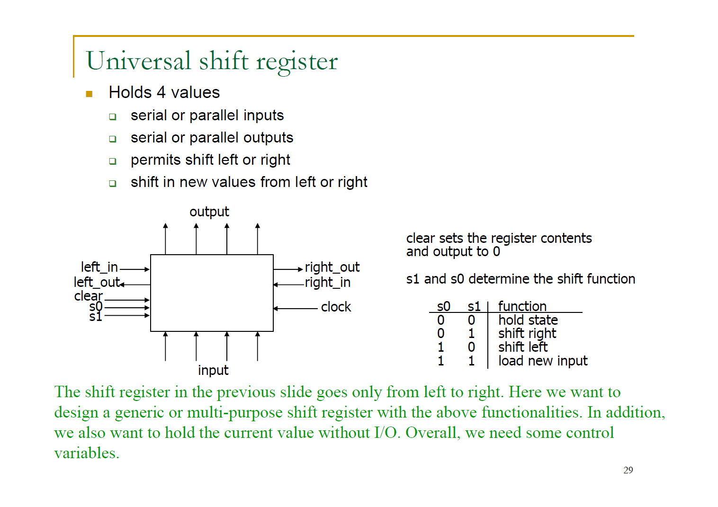
RUBIS

Slide 30
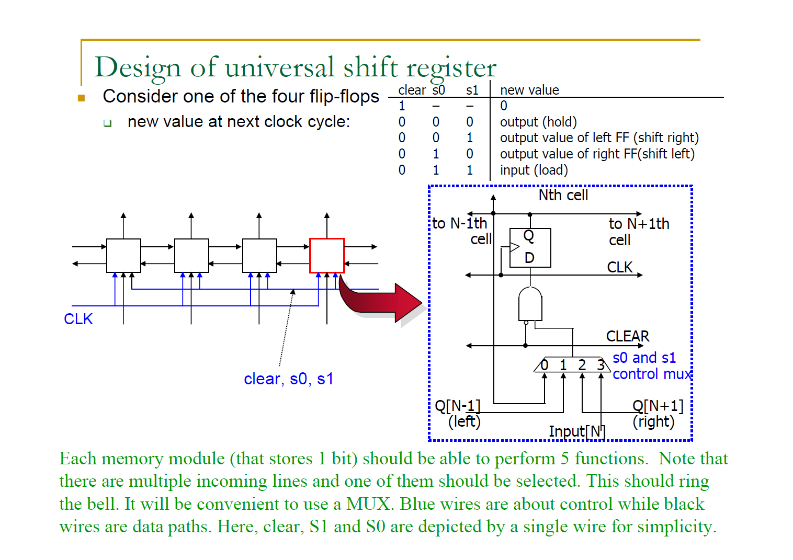
RUBIS

Slide 31
Requirement on your report (update)
VHDL basic
Design any combinational logic and show your codes and simulation result
  Too simple logic won’t get high score (ex. 2-input and gate)
Design ‘universal shift register’ logic and show your codes and simulation result
  You don’t have to simulate all possible cases
  Show at least 5 cases clearly – clear, left shift, right shift, load, hold
RUBIS

